Slide 1
Classification
Rule Based Classifier
Direct Method : RIPPER Algorithm
Indirect Method : Decision Tree
Naïve Bayes Classifier

Slide 2
Instance Elimination
Why do we need to eliminate instances?
Otherwise, the next rule is identical to previous rule
Why do we remove positive instances?
Ensure that the next rule is different
Why do we remove negative instances?
Prevent underestimating accuracy of rule
Compare rules R2 and R3 in the diagram

Slide 3
Stopping Criterion and Rule Pruning
Stopping criterion
Compute the gain
If gain is not significant, discard the new rule
Rule Pruning
Similar to post-pruning of decision trees
Reduced Error Pruning:
Remove one of the conjuncts in the rule
Compare error rate on validation set before and after pruning
If error improves, prune the conjunct

Slide 4
Direct Method: RIPPER
For 2-class problem, choose one of the classes as positive class, and the other as negative class
Majority class will be default class (Positive)
Learn rules for minority class (Negative)
For multi-class problem
Order the classes according to increasing class prevalence (fraction of instances that belong to a particular class)
Learn the rule set for smallest class first, treat the rest as negative class
Repeat with next smallest class as positive class

Slide 5
Direct Method: RIPPER
Growing a rule:
Start from empty rule
Add conjuncts as long as they improve FOIL’s information gain
Stop when rule no longer covers negative examples
Prune the rule immediately using incremental reduced error pruning
Measure for pruning: v = (p-n)/(p+n)
p: number of positive examples covered by the rule in the validation set
n: number of negative examples covered by the rule in the validation set
Pruning method: delete any final sequence of conditions that maximizes v

Slide 6
Rule Growing (Examples)
CN2 Algorithm:
Start from an empty conjunct: {}
Add conjuncts that minimizes the entropy measure: {A}, {A,B}, …
Determine the rule consequent by taking majority class of instances covered by the rule
RIPPER Algorithm:
Start from an empty rule: {} => class
Add conjuncts that maximizes FOIL’s information gain measure:
R0: {} => class (initial rule)
R1: {A} => class (rule after adding conjunct)
Gain(R0, R1) = t [ log (p1/(p1+n1)) – log (p0/(p0 + n0)) ]
where t: number of positive instances covered by both R0 and R1
p0: number of positive instances covered by R0
n0: number of negative instances covered by R0
p1: number of positive instances covered by R1
n1: number of negative instances covered by R1

Slide 7
Direct Method: RIPPER
Building a Rule Set:
Use sequential covering algorithm
Finds the best rule that covers the current set of positive examples
Eliminate both positive and negative examples covered by the rule
Each time a rule is added to the rule set, compute the new description length
stop adding new rules when the new description length is d bits longer than the smallest description length obtained so far

Slide 8
Direct Method: RIPPER
Optimize the rule set:
For each rule r in the rule set R
Consider 2 alternative rules:
Replacement rule (r*): grow new rule from scratch
Revised rule(r’): add conjuncts to extend the rule r
Compare the rule set for r against the rule set for r* and r’
Choose rule set that minimizes MDL principle
Repeat rule generation and rule optimization for the remaining positive examples

Slide 9
Summary of Direct Method
Grow a single rule
Remove Instances from rule
Prune the rule (if necessary)
Add rule to Current Rule Set
Repeat

Slide 10
Indirect Method: C4.5rules
Extract rules from an unpruned decision tree
For each rule, r: A → y, consider pruning the rule
Use class ordering
– Each subset is a collection of rules with the same rule consequent (class)
– Classes described by simpler sets of rules tend to appear first

Slide 12
Indirect Method: C4.5rules
Extract rules from an unpruned decision tree
For each rule, r: A → y,
consider an alternative rule r’: A’ → y where A’ is obtained by removing one of the conjuncts in A
Compare the pessimistic error rate for r against all r’s
Prune if one of the r’s has lower pessimistic error rate
Repeat until we can no longer improve generalization error

Slide 13
Indirect Method: C4.5rules
Instead of ordering the rules, order subsets of rules (class ordering)
Each subset is a collection of rules with the same rule consequent (class)
Compute description length of each subset
Description length = L(error) + g L(model)
g is a parameter that takes into account the presence of redundant attributes in a rule set (default value = 0.5)

Slide 14
Example

Slide 15
C4.5 rules versus RIPPER
C4.5rules:
(Give Birth=No, Can Fly=Yes) → Birds
(Give Birth=No, Live in Water=Yes) → Fishes
(Give Birth=Yes) → Mammals
(Give Birth=No, Can Fly=No, Live in Water=No) → Reptiles
( ) → Amphibians
RIPPER:
(Live in Water=Yes) → Fishes
(Have Legs=No) → Reptiles
(Give Birth=No, Can Fly=No, Live In Water=No) → Reptiles
(Can Fly=Yes,Give Birth=No) → Birds
() → Mammals

Slide 16
C4.5rules versus RIPPER
C4.5rules:
RIPPER:

Slide 17
Advantages of Rule-Based Classifiers
As highly expressive as decision trees
Easy to interpret
Easy to generate
Can classify new instances rapidly
Performance comparable to decision trees

Slide 18
Classification
Bayesian Classifier
Naive Bayes Classifier

Slide 19
Bayesian Classification
What are Bayesian Classifiers?
Statistical Classifiers
Predict class membership probabilities
Based on Bayes Theorem
Naïve Bayesian Classifier
Computationally Simple
Comparable performance with DT and NN classifiers

Slide 20
Bayesian Classification
Probabilistic learning: Calculate explicit probabilities for hypothesis, among the most practical approaches to certain types of learning problems
Incremental: Each training example can incrementally increase/decrease the probability that a hypothesis is correct. Prior knowledge can be combined with observed data.

Slide 21
Bayes Theorem
Let X be a data sample whose class label is unknown
Let H be some hypothesis that X belongs to a class C
For classification determine P(H|X)
P(H|X) is the probability that H holds given the observed data sample X
P(H|X) is posterior probability of H conditioned on X

Slide 22
Bayes Theorem
Example: Sample space: All Fruits described by their color and shape
X is “round” and “red”
H= hypothesis that X is an Apple
P(H|X) is our confidence that X is an apple given that X is “round” and “red”
P(H) is Prior Probability of H, i.e. the probability that any given data sample is an apple regardless of how it looks
P(H|X) is based on more information
Note that P(H) is independent of X

Slide 23
Bayes Theorem
Example: Sample space: All Fruits
P(X|H) ?
It is the probability that X is round and red given that we know that it is true that X is an apple
Here P(X) is prior probability =
P(data sample from our set of fruits is red and round)

Slide 24
Estimating Probabilities
P(X), P(H), and P(X|H) may be estimated from given data
Bayes Theorem
Use of Bayes Theorem in Naïve Bayesian Classifier!!

Slide 25
Bayesian Classifiers
Consider each attribute and class label as random variables
Given a record with attributes (A₁, A₂,…,A_{n})
Goal is to predict class C
Specifically, we want to find the value of C that maximizes P(C| A₁, A₂,…,A_{n} )
Can we estimate P(C| A₁, A₂,…,A_{n} ) directly from data?

Slide 26
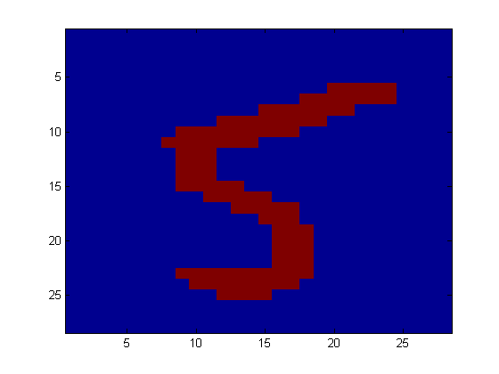
Application
Digit Recognition
X₁,…,X_{n} ∈ {0,1} (Black vs. White pixels)
Y ∈ {5,6} (predict whether a digit is a 5 or a 6)
Classifier
5

Slide 27

The Bayes Classifier
In class, we saw that a good strategy is to predict:
(for example: what is the probability that the image represents a 5 given its pixels?)
So … How do we compute that?

Slide 28
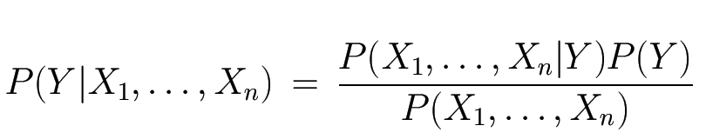
The Bayes Classifier
Use Bayes Rule!
Why did this help? Well, we think that we might be able to specify how features are “generated” by the class label
Likelihood
Prior
Normalization Constant

Slide 29
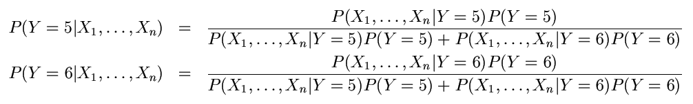
The Bayes Classifier
Let’s expand this for our digit recognition task:
To classify, we’ll simply compute these two probabilities and predict based on which one is greater

Slide 30
Model Parameters
For the Bayes classifier, we need to “learn” two functions, the likelihood and the prior
How many parameters are required to specify the prior for our digit recognition example?

Slide 31
Model Parameters
How many parameters are required to specify the likelihood?
(Supposing that each image is 30x30 pixels)
?

Slide 32
Model Parameters
The problem with explicitly modeling P(X₁,…,X_{n}|Y) is that there are usually way too many parameters:
We’ll run out of space
We’ll run out of time
And we’ll need tons of training data (which is usually not available)

Slide 33
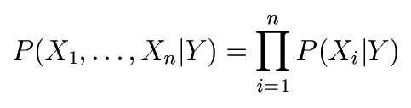
The Naïve Bayes Model
The Naïve Bayes Assumption: Assume that all features are independent given the class label Y
Equationally speaking:

Slide 34
Why is this useful?
# of parameters for modeling P(X₁,…,X_{n}|Y):
2(2^{n}-1)
# of parameters for modeling P(X₁|Y),…,P(X_{n}|Y)
2n

Slide 35
Naïve Bayesian Classification
Also called Simple Bayesian Classification
Why Naïve/Simple??
Class Conditional Independence
Effect of an attribute values on a given class is independent of the values of other attributes
This assumption simplifies computations

Slide 36
Bayesian Classifiers
Approach:
compute the posterior probability P(C | A₁, A₂, …, A_{n}) for all values of C using the Bayes theorem
Choose value of C that maximizes P(C | A₁, A₂, …, A_{n})
Equivalent to choosing value of C that maximizes P(A₁, A₂, …, A_{n}|C) P(C)
How to estimate P(A₁, A₂, …, A_{n} | C )?

Slide 37
Naïve Bayes Classifier
Assume independence among attributes A_{i} when class is given:
P(A₁, A₂, …, A_{n} |C) = P(A₁| C_{j}) P(A₂| C_{j})… P(A_{n}| C_{j})
Can estimate P(A_{i}| C_{j}) for all A_{i} and C_{j}.
New point is classified to C_{j} if P(C_{j}) Π P(A_{i}| C_{j}) is maximal.

Slide 38
How to Estimate Probabilities from Data?
Class: P(C) = N_{c}/N
e.g., P(No) = 7/10, P(Yes) = 3/10
For discrete attributes: P(A_{i} | C_{k}) = |A_{ik}|/ N_{c}
where |A_{ik}| is number of instances having attribute A_{i} and belongs to class C_{k}
Examples:
P(Status=Married|No) = 4/7 P(Refund=Yes|Yes)=0
k

Slide 39
How to Estimate Probabilities from Data?
For continuous attributes:
Discretize the range into bins
Two-way split: (A < v) or (A > v)
choose only one of the two splits as new attribute
Probability density estimation:
Assume attribute follows a normal distribution
Use data to estimate parameters of distribution (e.g., mean and standard deviation)
Once probability distribution is known, can use it to estimate the conditional probability P(A_{i}|c)

Slide 40
How to Estimate Probabilities from Data?
Normal distribution:
One for each (A_{i},c_{i}) pair
For (Income, class=No):
If Class=No
sample mean = 110
sample variance = 2975

Slide 41
Example of Naïve Bayes Classifier
Given a Test Record:
P(X|Class=No) = P(Refund=No|Class=No) × P(Married| Class=No) × P(Income=120K| Class=No) = 4/7 × 4/7 × 0.0072 = 0.0024
P(X|Class=Yes) = P(Refund=No| Class=Yes) × P(Married| Class=Yes) × P(Incm=120K| Class=Yes) = 1 × 0 × 1.2 × 10⁻⁹ = 0
Since P(X|No)P(No) > P(X|Yes)P(Yes)
Therefore P(No|X) > P(Yes|X) => Class = No

Slide 42
Naïve Bayes Classifier
If one of the conditional probability is zero, then the entire expression becomes zero
Probability estimation:
c: number of classes
p: prior probability
m: parameter

Slide 43
Example of Naïve Bayes Classifier
A: attributes
M: mammals
N: non-mammals
P(A|M)P(M) > P(A|N)P(N)
=> Mammals

Slide 44
Naïve Bayesian Classification
Example
Age
Income
Student
Credit_rating
Class:Buys_comp
<=30
HIGH
N
FAIR
N
<=30
HIGH
N
EXCELLENT
N
31…..40
HIGH
N
FAIR
Y
>40
MEDIUM
N
FAIR
Y
>40
LOW
Y
FAIR
Y
>40
LOW
Y
EXCELLENT
N
31…..40
LOW
Y
EXCELLENT
Y
<=30
MEDIUM
N
FAIR
N
<=30
LOW
Y
FAIR
Y
>40
MEDIUM
Y
FAIR
Y
<=30
MEDIUM
Y
EXCELLENT
Y
31….40
MEDIUM
N
EXCELLENT
Y
31….40
HIGH
Y
FAIR
Y
>40
MEDIUM
N
EXCELLENT
N

Slide 45
Naïve Bayesian Classification
Example
A= (<=30,MEDIUM, Y,FAIR, ???)
We need to max.
P(A|C_{j})P(C_{j}) for j =1,2.
P(C_{j}) is computed from training sample
P(buys_comp=Y) = 9/14 = 0.643
P(buys_comp=N) = 5/14 = 0.357
How to calculate P(X|C_{i})P(C_{i}) for i=1,2?
P(A|C_{j}) P(A₁, A₂, A₃, A₄|C) = ΠP(A_{k}|C)

Slide 46
Naïve Bayesian Classification
Example
P(age<=30 | buys_comp=Y)=2/9=0.222
P(age<=30 | buys_comp=N)=3/5=0.600
P(income=medium | buys_comp=Y)=4/9=0.444
P(income=medium | buys_comp=N)=2/5=0.400
P(student=Y | buys_comp=Y)=6/9=0.667
P(student=Y | buys_comp=N)=1/5=0.200
P(credit_rating=FAIR | buys_comp=Y)=6/9=0.667
P(credit_rating=FAIR | buys_comp=N)=2/5=0.400

Slide 47
Naïve Bayesian Classification
Example
P(X | buys_comp=Y)=0.222*0.444*0.667*0.667=0.044
P(X | buys_comp=N)=0.600*0.400*0.200*0.400=0.019
P(X | buys_comp=Y)P(buys_comp=Y) = 0.044*0.643=0.028
P(X | buys_comp=N)P(buys_comp=N) = 0.019*0.357=0.007
CONCLUSION: A buys computer

Slide 48
Naïve Bayes (Summary)
Robust to isolated noise points
Handle missing values by ignoring the instance during probability estimate calculations
Robust to irrelevant attributes
Independence assumption may not hold for some attributes
Use other techniques such as Bayesian Belief Networks (BBN)

